Slide 1

Chapter 7
Resist Conspiracy Theories
Notes:
-In this chapter we review what makes for successful conspiracy theories
-We also explain how improbable it is that the gospel accounts could be a conspiracy theory

Slide 2
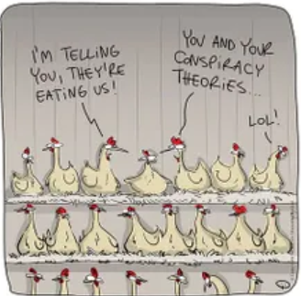
What is a Conspiracy Theory?
a secret plan or agreement between persons for an unlawful or harmful purpose such as murder, treason or theft. Or some other crime.
The alleged conspiracy is that the apostles claimed Jesus was resurrected from the dead and ascended into Heaven.
Notes:
A conspiracy to hide the truth of what really happened

Slide 3
The Bible a conspiracy?
alleged conspiracy is that the apostles claimed Jesus was resurrected from the dead and ascended into Heaven.
There are movies that paint Christianity as a production of prior mythologies that were mixed up together to produce a lie, perpetuated by a group of people who kept the conspiracy to their graves.

Slide 4



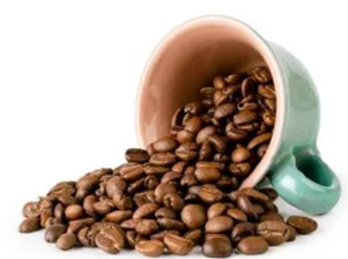
Successful Conspiracies
Small number of conspirators
Thorough and immediate communication
Short time span
Significant relational connections
Little or no pressure
Notes:
1.)The larger the number of co-conspirators, the more likely you will have someone telling the truth so that the conspiracy fails.
2.)When co-conspirators are unable to determine if their partners in crime have told the truth, they are very likely to fess up to their crimes to save their own hide. We see that kind of behavior in movies all the time.
3.)Lies are often hard to tell once, but a lot harder to tell over a long period of time without inconsistencies boiling up.
4.)With conspiracies, the greater the bond (ie. family) between the conspirators, the higher chance they will pull off a conspiracy without one person ratting out the other.
5.)The greater that pressure on co-conspirators, the less likely they will keep their mouths shut to save themselves from punishment.
In other words, the more co-conspirators realize they are in trouble and how much it will cost for not telling the truth, the more likely they will spill the beans.

Slide 5
Unsuccessful Conspiracy Traits
Bad Communication: Ancient times
Relationships: most apostles not related
Time: Apostle John lived upwards of 60 years
Lots of pressure. All martyred besides John
Notes:
-Bad - Ancient Times: no good way to keep in constant communication. Imagine a… Peter, did you spill the beans about Jesus yet?
-Relationships - many were complete strangers to one another
-Time -Apostles were apart more than together.
-Lots - The apostles were aggressively persecuted as they were scattered from Italy to India. According to the records we have on the immense pressure on the apostles, Peter was crucified upside down in Rome, James was killed by the sword in Jerusalem, Thomas was murdered by a mob in Mylapoe, India.
Many of the martyrdom accounts are gruesome.
Yet none recanted.
-

Slide 6
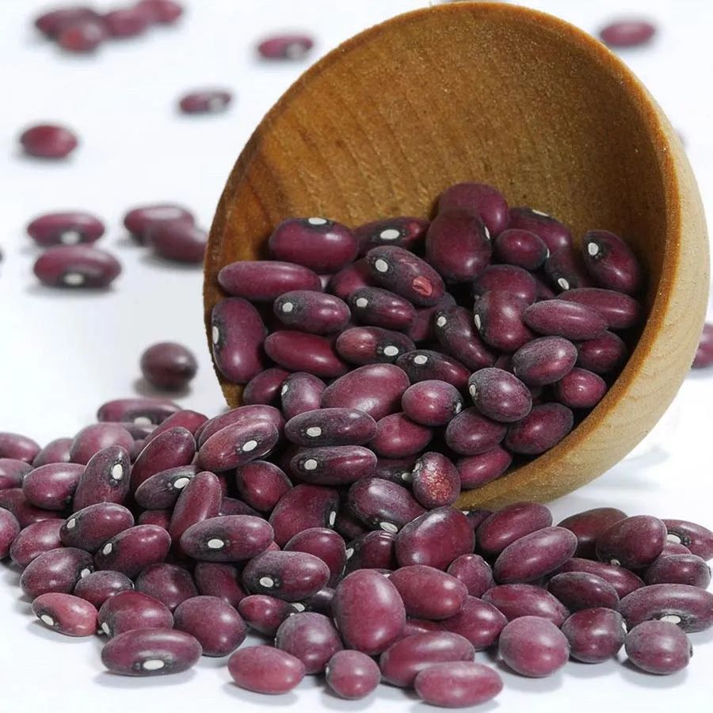
Scenario
Murder happens
Little evidence to prosecute
Interrogator severs communication
Adds pressure
Exploits lack of relational connectiveness
Breaks conspiracy
Notes:
Author gives an example where two street thugs murder a man and there is little evidence to prosecute.
-The interrogator separates the suspects immediately (severs communication #2)
-Interrogator convinces one suspect that his buddy is about to fess up (#5 adds pressure to tell the truth)
-#4 the two suspects have no family relation
-Short time span: Lies are hard enough to tell once. Add years to that and hundreds of conspirators and you have a hard conspiracy to maintain.

Slide 7

Gospel accounts a conspiracy?

Slide 8
Factors against the apostles
Large number of participants
Bad Communication: ancient times
Long span of time
Most apostles not related
Lots of pressure
Notes:
1.) 12 apostles and at least hundreds of witnesses of the resurrected Jesus of Nazareth.
2.)Most of the apostles had no family relation to one another.
Many of them were complete strangers before they met Jesus.
3.)The apostles were aggressively persecuted as they were scattered from Italy to India.
4.)the apostle John living the longest of all the apostles would have to had kept the alleged lies for an upward of 60 years.
The short years they spent together with Jesus was nothing compared to the decades they spent apart.
5.)According to the records we have on the immense pressure on the apostles, Peter was crucified upside down in Rome, James was killed by the sword in Jerusalem, Thomas was murdered by a mob in Mylapoe, India.
Many of the martyrdom accounts are gruesome.

Slide 9
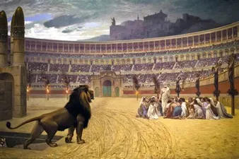
Does Dying for a Belief make that Belief More Valid?

Slide 10
But Jihadists Die for their Belief
The apostles died for something they definitely knew was true
Jihadists die for something they mistakenly thought to be true
Notes:
Martyrdom is not necessarily a 100% indicator of truth-telling

Slide 11
Don’t believe all Conspiracy Theories
There are movies that paint Christianity as a production of prior mythologies that were mixed up together to produce a lie, perpetuated by a group of people who kept the conspiracy to their graves.
Our culture is ripe with the fascination of conspiracy theories, so it's easy to bunch Christianity into another one of them.

Slide 12
Successful Conspiracies
Successful conspiracies occur every day, but typically involve a small number of incredibly close-knit people who are in constant contact with one another for a short period of time and without any pressure.
Either the apostles and eye witnesses of Jesus' ascension and resurrection were part of the world's greatest conspiracy or were simply telling the truth.

Slide 13
Closing Thoughts
Successful, large-scale conspiracy theories are rare.
When judging if a conspiracy is reasonable, think about: # of conspirators, communication, time, relationships, and pressure
Someone who says the resurrection of Christ is a conspiracy theory are likely not informed on how evidentially unreasonable their claim is
Now you know how to debunk the resurrection conspiracy claim

Slide 14
for more information visit:
www.ColdCaseChristianity.com

